Slide 1
Carbon Emissions Across the United States
Team Members: Supriya Vadakkeveetil, Riptapan Singh Johal, and Garrett Stiehl

Slide 2
Project Description
The project on Carbon emissions across United States aims to perform an Exploratory Data Analysis to investigate the Carbon Emissions in United States, focusing mainly on region wise analysis and the contributors for Carbon Emissions. We will explore public datasets, employ data analysis methods to dig deeper into the environmental impact and mainly its impact on health of people in United states. The motivation for the project comes from the need to understand the challenges to the environment caused by carbon emissions and the sustainability initiatives being undertaken to curb these emissions.

Slide 3
Research Questions
What were the CO2 emissions in the United States over the past decade?
How do these emissions vary across the country?
What are the impacts of these carbon emissions?

Slide 4
Research Data
We have taken data through a variety of valuable resources including,
US EPA (Environmental Protection Agency) – Data (Historical) on the Greenhouse gas emissions in the United States
US EIA (Energy Information Administration) – Data on State level emissions, Energy production and Electricity Generation Source.
NREL (National Renewable Energy Laboratory)- Data on Renewable energy production and consumption
CDC and National Center for Health Statistics (NCHS)

Slide 5
Data Cleanup

Slide 6
Our Analysis Processes

Slide 7
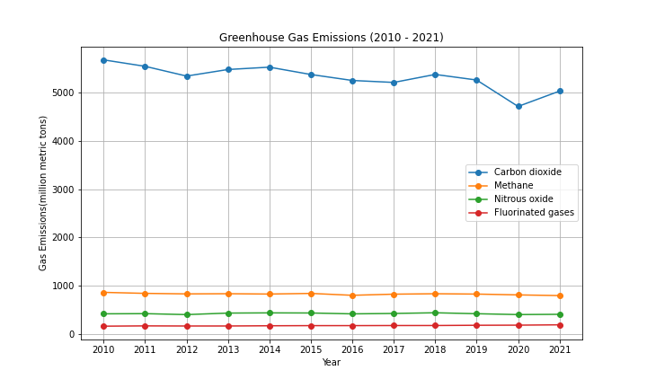
Emission Types
Carbon dioxide consistently sits nearly five times higher than methane, nitrous oxide, or fluorinated gases.

Slide 8
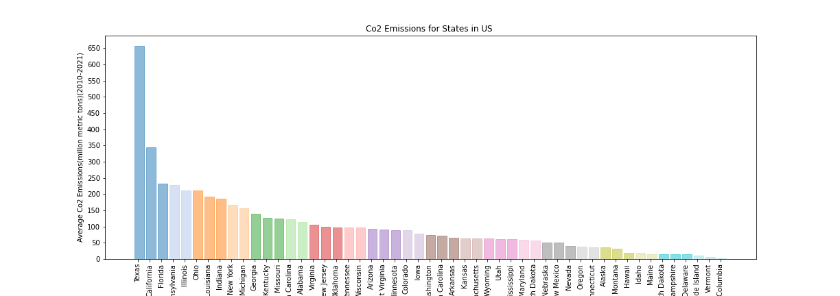
Co2 Emissions for States in the US
Texas and California, two of the largest states in the US, are the two highest producers of Co2 Emissions, followed by Florida, Pennsylvania, Illinois, and Ohio
Texas’ emissions are significantly higher than any other state

Slide 9
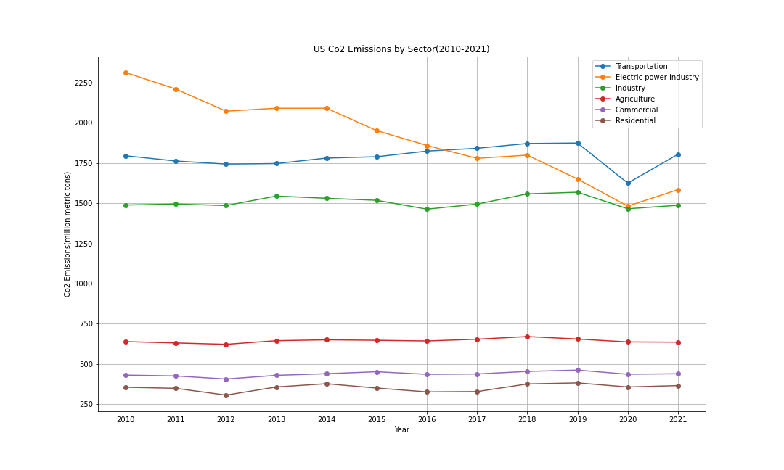
Emissions By Sector
Electric power industry, transportation, and industry sectors have remained the three highest producers of Co2 emissions
In recent years, the top three producers have decreased emissions to be between 1500 to approximately 1800 mmt
A significant gap has remained between the top three producers and the bottom three, with nearly a 3500 mmt difference

Slide 10
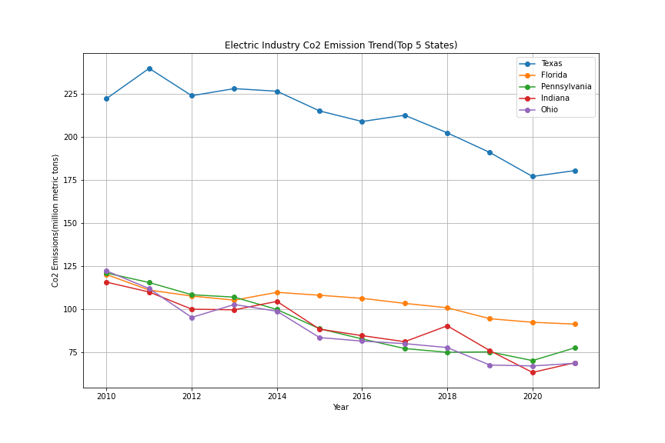
Electric CO2 Emissions
Texas’ electric industry Co2 emissions is around 100 mmt more than four out of the top five Co2 producing states
There has been a gradual downward trend in all five of the top five Co2 producing states in the last 10 years

Slide 11
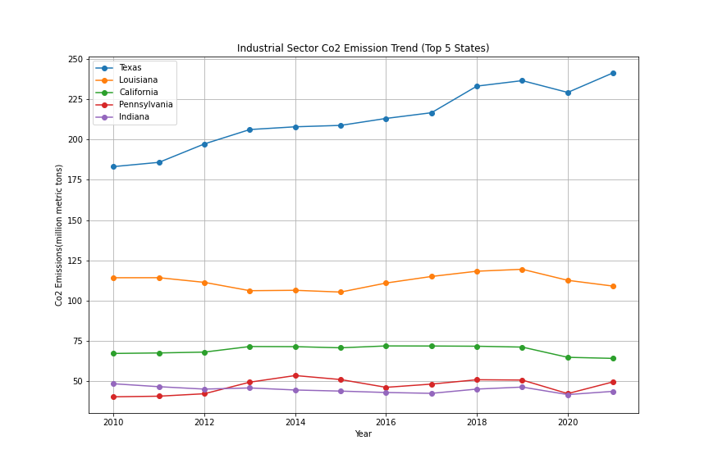
Industrial CO2
Texas’ industrial sector is also the highest contributor among the top five states
Texas also displays a gradual upward trend in industrial Co2 emissions, whereas other states remain steady
Texas currently sits above 225 mmt, whereas the other four states are all below 125 mmt

Slide 12
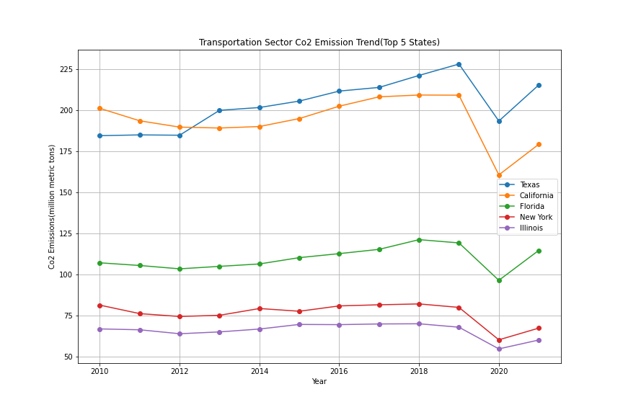
Transportation CO2
The top five Co2 producers change for the transportation sector, with Texas being the only to remain
Texas and California are the highest Co2 contributors in the transportation sector and both follow similar trends over the past 10 years
All five states experiences a sharp rise in emissions after 2020

Slide 13
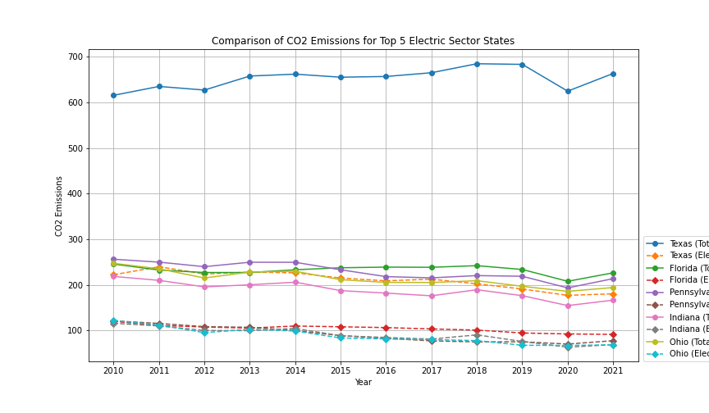
Comparison of CO2 Emissions for Top 5 Electric Sector States
Not Sure

Slide 14
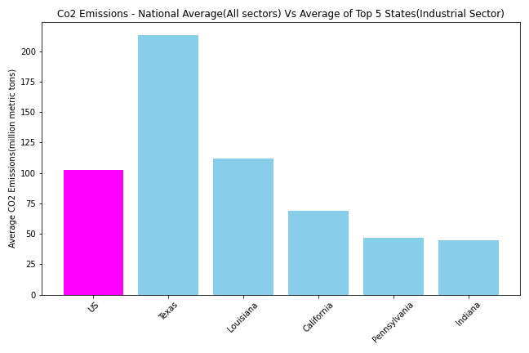
National VS State Average
Not Sure

Slide 15
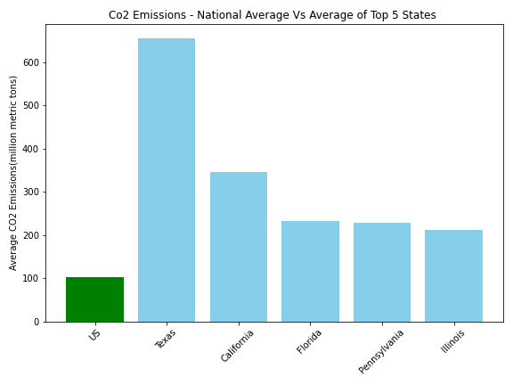
National VS State
The national average of CO2 emissions is minimal compared to the top 5 producing states.
Texas, California, Florida, Pennsylvania and Illinois are the leading states in CO2 emissions.
The gap between the leading state, Texas, and California in CO2 emissions accurately show the difference between California's push to quadruple clean energy production while Texas so no current goals.

Slide 16
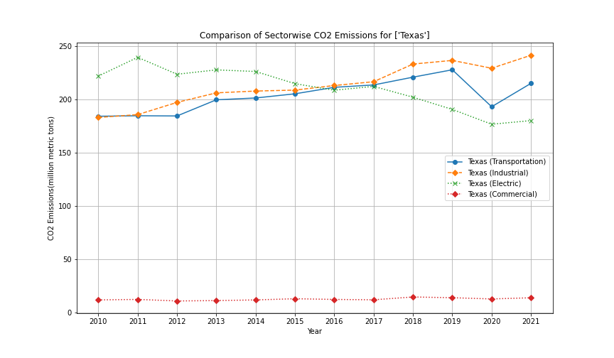
Deeper Dive Into Texas
From 2019 to 2020 Texas experienced a sudden decrease in all sectors CO2 emissions.

Slide 17
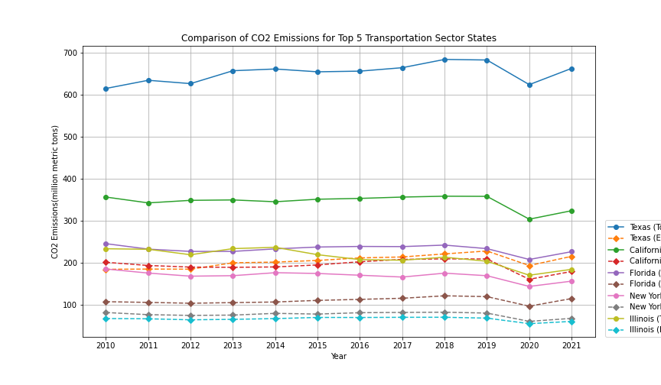
Top 5 Transportation CO2 States

Slide 18
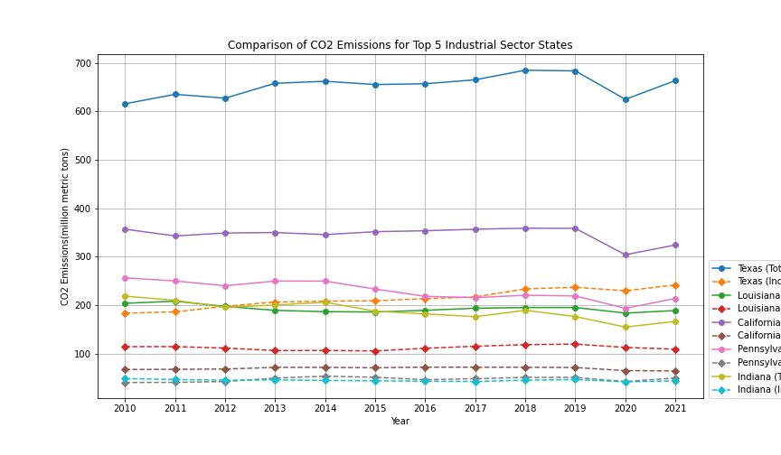
Top 5 Industrial CO2 States

Slide 19
Impacts Analysis

Slide 20
Conclusions

